Slide 1
Case 2
3.4 Harvesting
Warning:
where

Slide 2
3.4 Harvesting
WHY?
See the last
two examples
N

Slide 3
3.4 Harvesting
N
B/s
-
Region 3
equi soln stable
Good region
Region 2
able to bounce back
equi soln unstable
Region 1
t
We have to ensure that the # of fish is not in the region 1,
since in this case , eventually, the population of fish will be zero.

Slide 4
Initial population
under harvesting model
is B/s

Slide 5
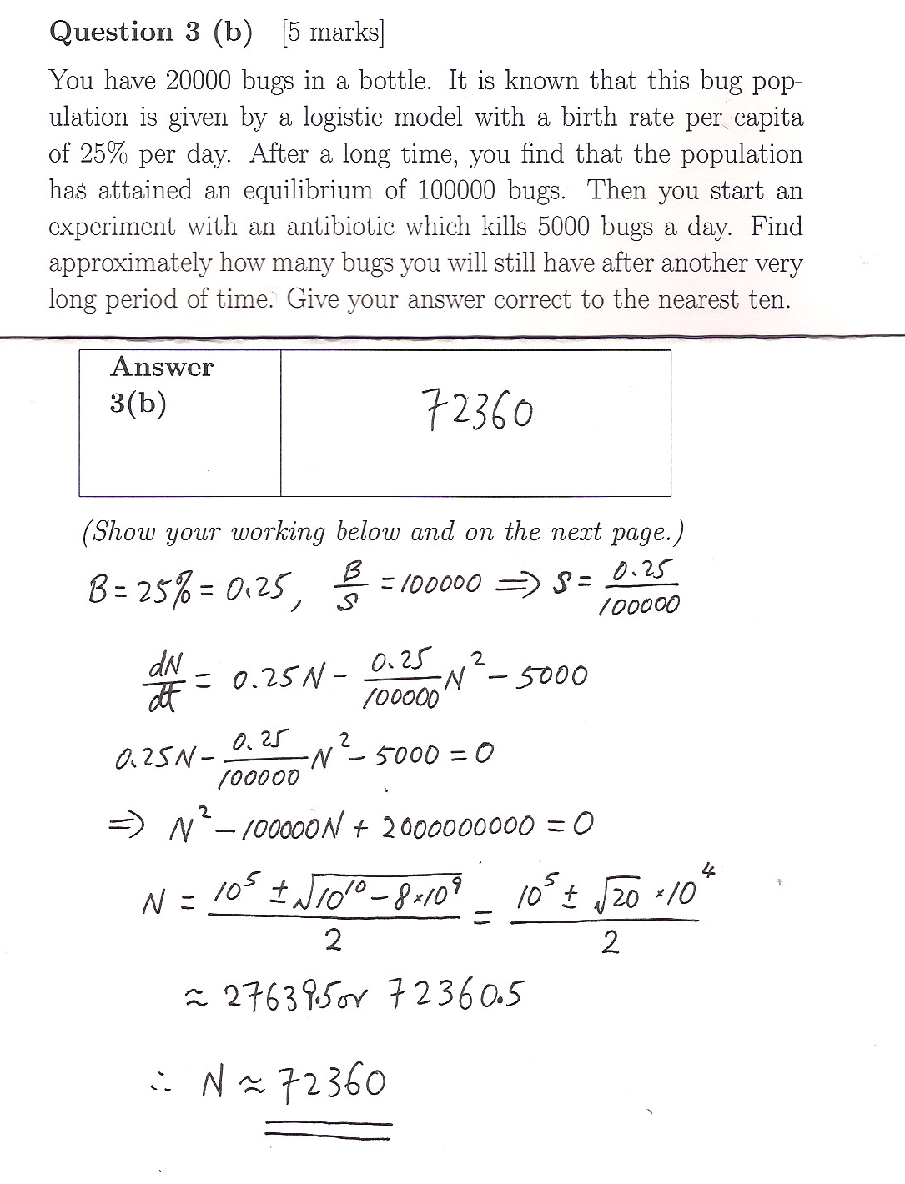

Slide 6
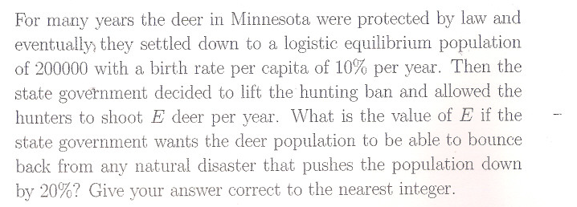
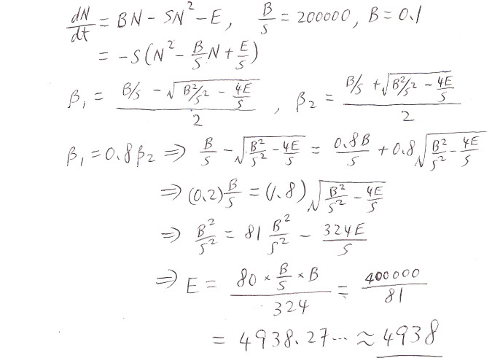
3.4 Harvesting
B/S

Slide 7
Recall
Suppose that one of the root is known, and a, b
are also given. How to find the constant c
It is known that
Hence we can find
Certainly, we can use formula
Furthermore,
Hence we can find c
to find the value c.
But the computation
of the 1st method is easier

Slide 8
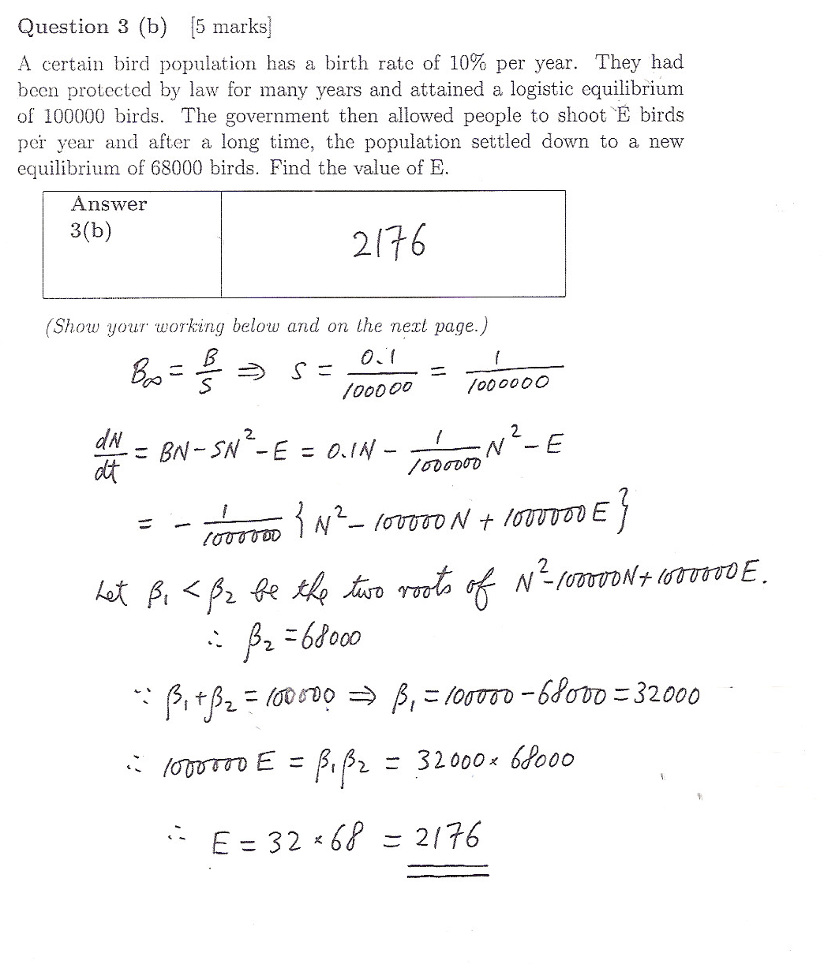

Slide 9
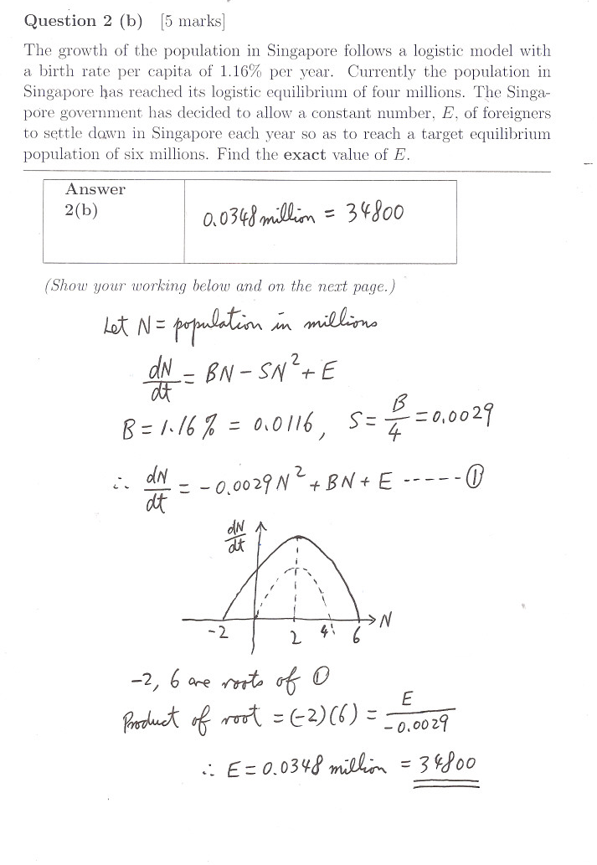
NOT a harvesting model

Slide 10
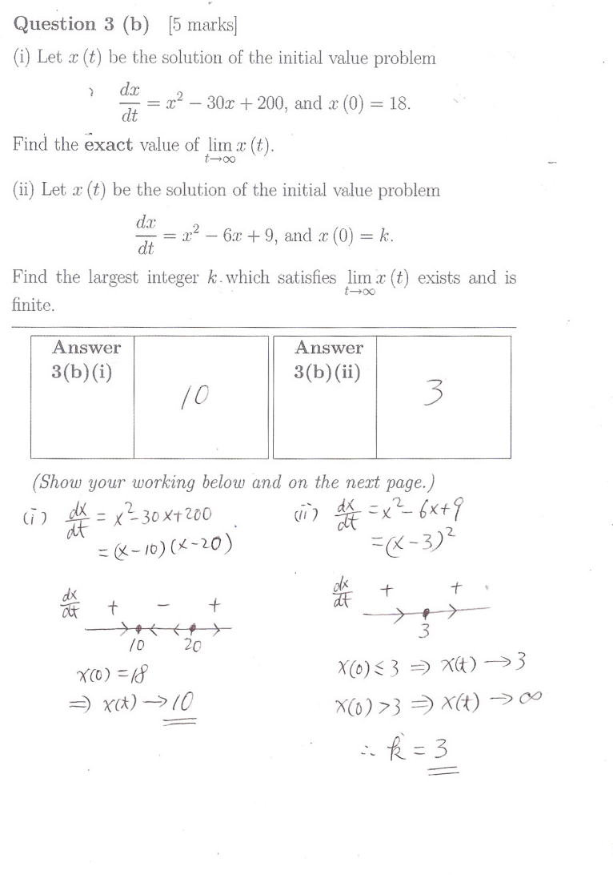
2012

Slide 11
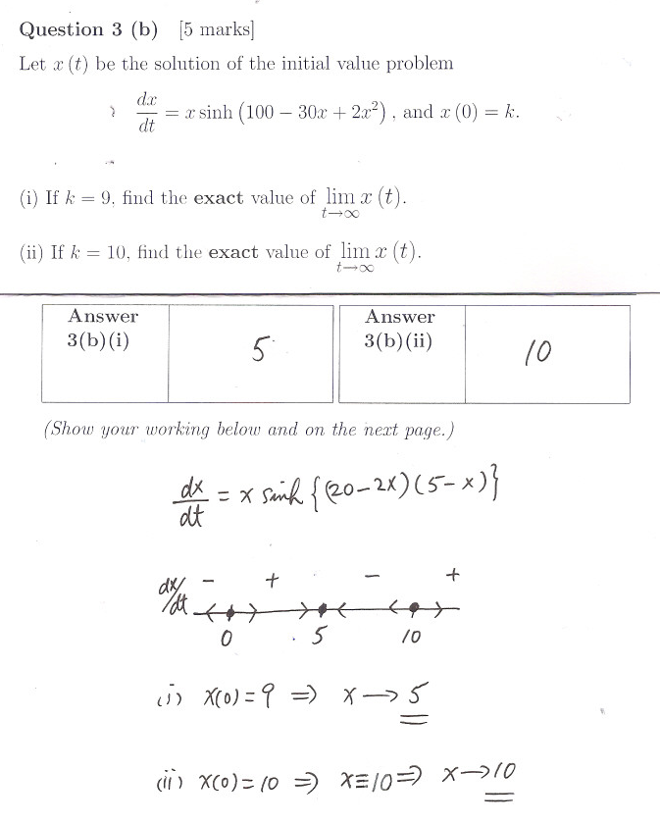

Slide 12
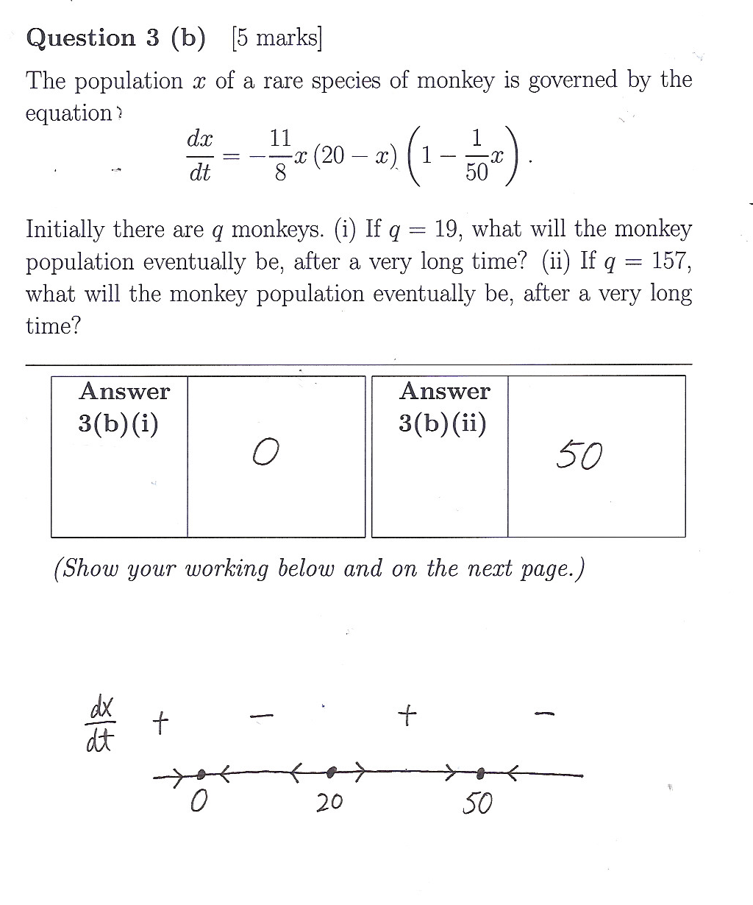

Slide 13
